Slide 1
Today
Lecture 22: Macroscopic quantum phenomena and superconductor qubits
Discussion of applications of superconductor materials and devices in five parts:
Overview of the quantum information landscape
Macroscopic quantum phenomena in superconductor devices and superconductor qubits
Decoherence and the emergence of the transmon qubit
Topological superconducting qubits based on Majorana fermion states
S-TI-S Josephson junctions --- a compelling platform
Next time
Lecture 23: Decoheerence and the Transmon qubit

Slide 2
Conventional SC qubits vs. topological SC qubits | SC qubits vs. ion trap qubits | SC qubits vs. quantum dot or semiconductor qubits
Abboud, Nick | Birchmier, Rachel Lucille | Fu, Wenning
Beach, Alexander R | Rooke, Spencer George | Ganesan, Vishal
Song, Xiangyu | Wild, Drew Glenn | Peng, Yu-Ting
Suresh Babu, Soorya | Wu, Junyi | Wu, Dufei
Quantum Supremacy | Superconductors for Quantum Sensing | Quantum computing for discovery of new superconductors
Gabrisko, Nick |  | Vaz, Daniel Edward
Kim, Dong Beom | Hu, Yuxuan | Zhang, Michael
Montone, Jessica H | Tsai, Pei-Wen | Zvenigorodsky, Serge
Wang, Ningdong |  | Apte, Sohm Shailesh
RESEARCH PAPERS
 | Agrawal, Shraddha
 | Baker, Carina Franziska
 | Lennox, Amber Rose Elizabeth
 | Lin, Haoran
 | Ma, Max

Slide 3
Superconductor qubits
Macroscopic Quantum Phenomena --- ways in which SC devices behave as quantum mechanical objects
Types of superconductor qubits
charge qubits
phase qubits
flux qubits
hybrid charge-phase qubits (one example is the transmon qubit)
Decoherence
  Characterization T₁, T₂
  Sources of decoherence
  Reducing decoherence
Transmon qubit --- developed to avoid decoherence

Slide 4
Macroscopic Quantum Phenomena
Superconductors are intrinsically coherent quantum systems --- we have seen this in Cooper pairing, Josephson tunneling, and the RSJ model in which we characterized the junction phase as a “particle” with inertia and damping moving in a “washboard” potential that incorporates the periodicity of the current-phase relation
However, there is another layer at which SC systems are “quantum” in which the “phase particle” itself, which represents the whole system, can behave quantum mechanically.
Three phenomena:
1. Macroscopic Quantum Tunneling (MQT) --- tunneling through the washboard potential
2. Quantized energy levels --- quantum mechanical behavior of the phase particle
3. Macroscopic Quantum Coherence (MQC) --- superposition of discrete quantum states
This was a major focus on superconductor device research in the 1980’s

Slide 5
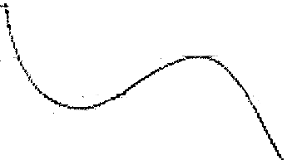

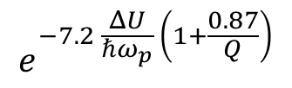



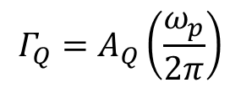
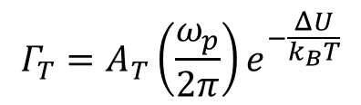
Macroscopic Quantum Tunneling (MQT) --- can a macroscopic system tunnel?
First test of QM in a microscopic system
Consider onset of resistance --- Can the phase particle tunneling from well, like a quantum object?
Electrons tunnel. Alpha particles tunnel? What about macroscopic objects?
Physics 214 problem: Can your car tunnel out of your garage?
Thermal activation
MQT
$$Γ$$
$$Γ_{T}=A_{T}\left(\frac{ω_{p}}{2π}\right)ⅇ^{−\frac{ΔU}{k_{B}T}}$$
where $Q=ω_{P}RC$
Rate flattens out at low T
$$Γ_{Q}=A_{Q}\left(\frac{ω_{p}}{2π}\right)$$
$$ⅇ^{−7.2 \frac{ΔU}{ℏω_{p}} \left(1+\frac{0.87}{Q}\right)}$$
I
$$T$$
$$T_{x}$$
Absence of damping (Q large), MQT dominates for $ℏω_{p}=7.2k_{B}T$

Slide 6
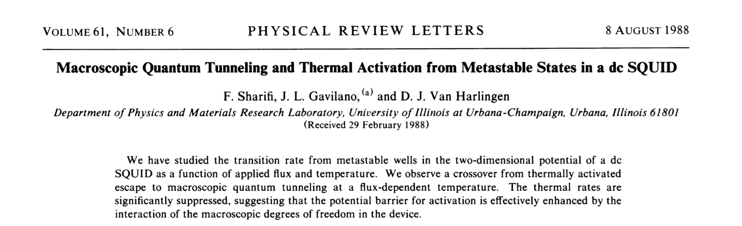
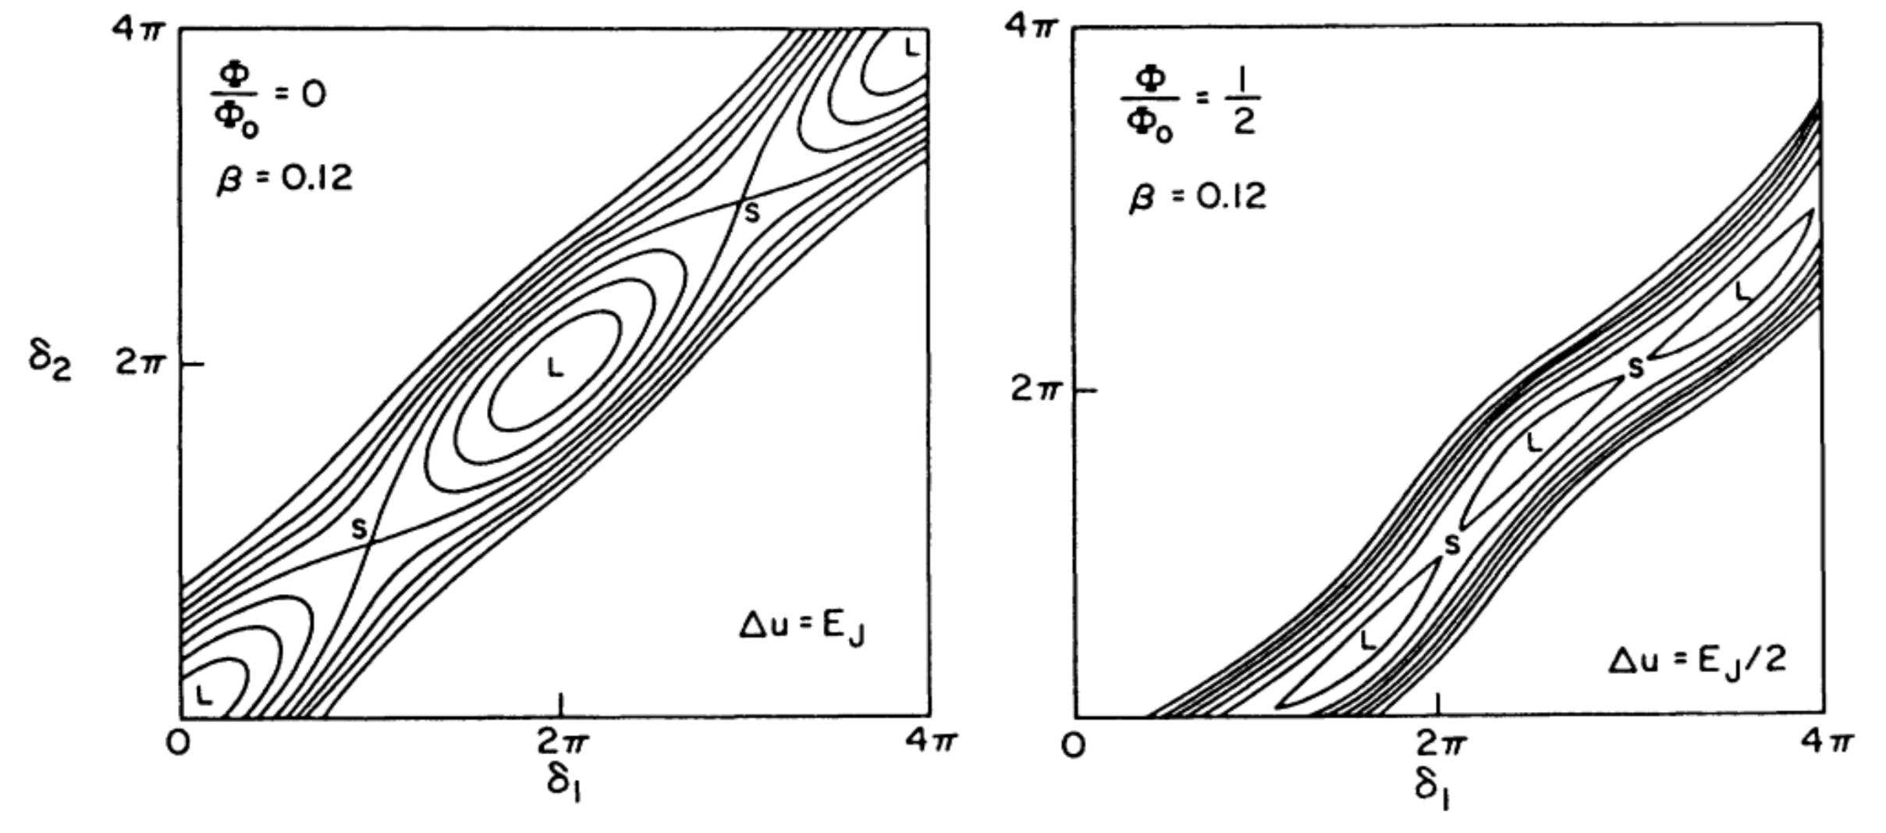
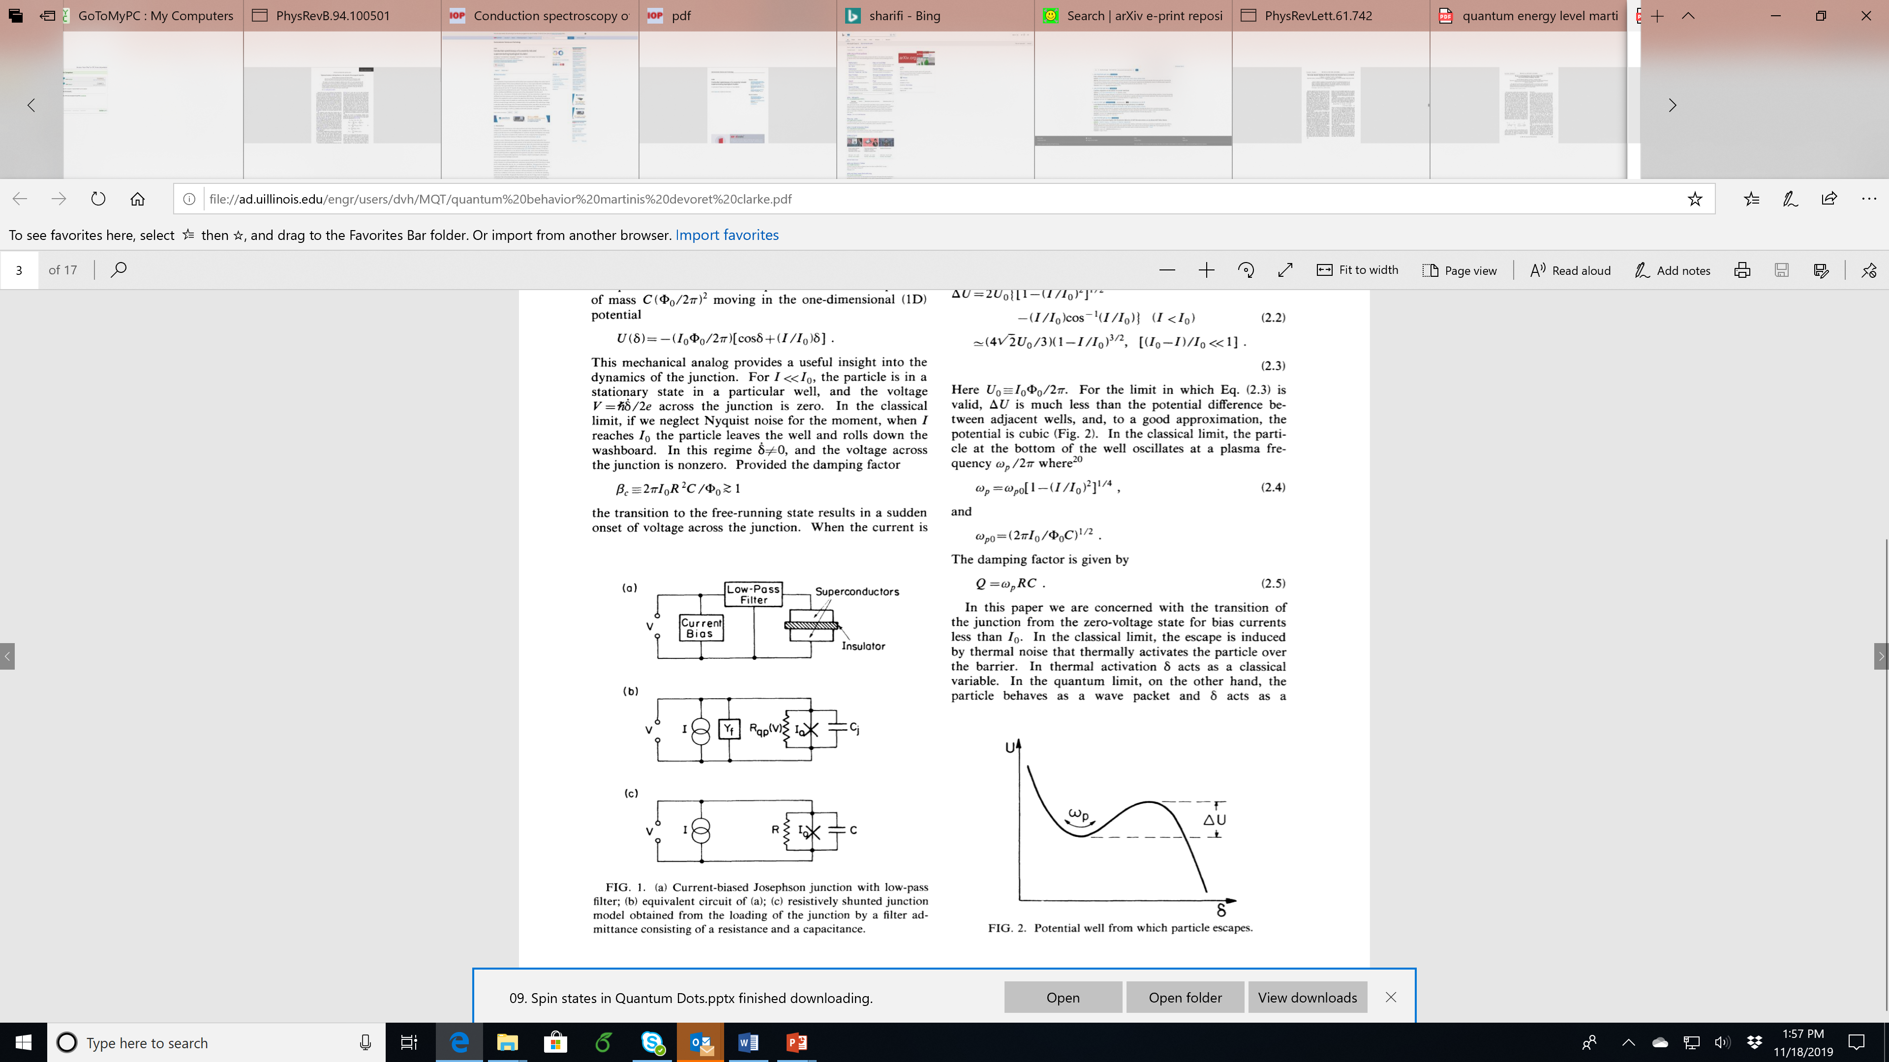
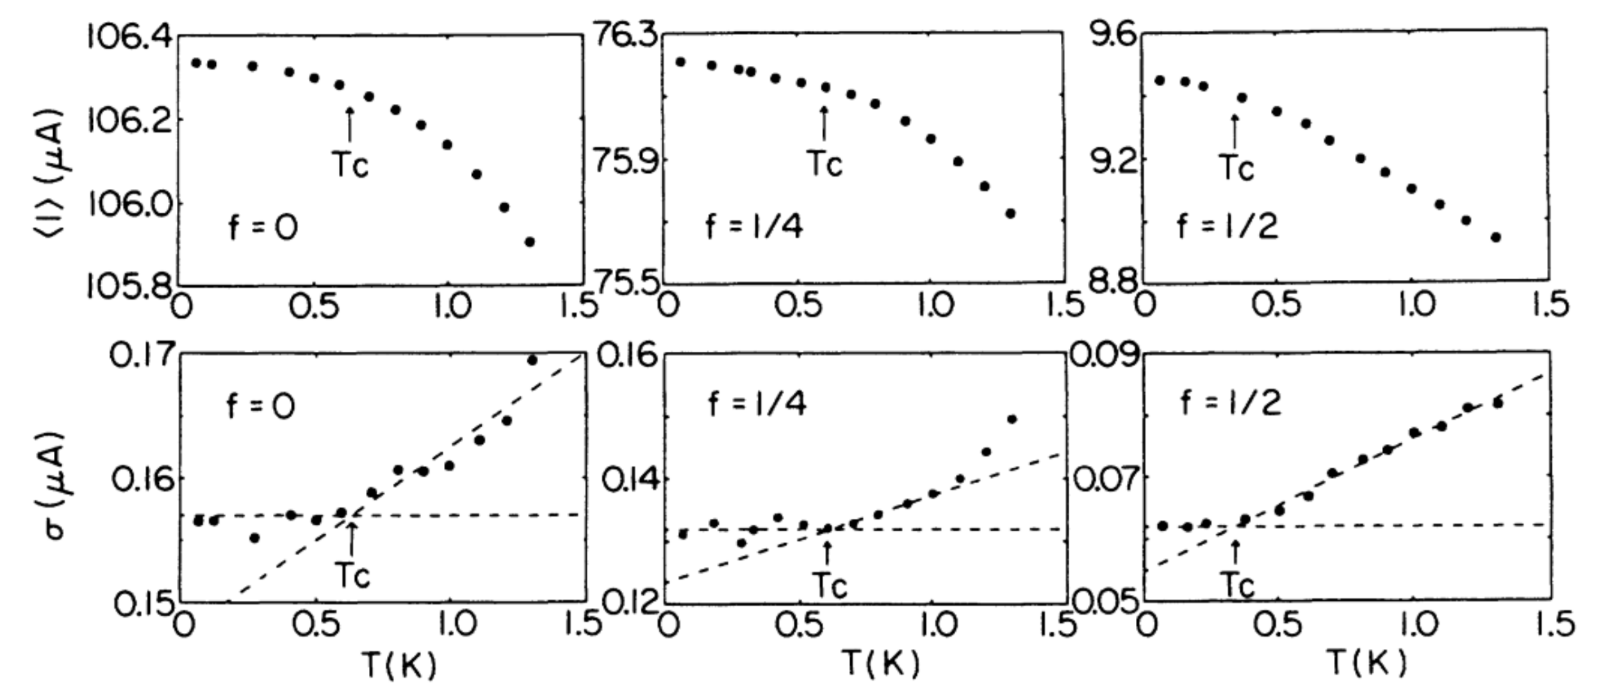
In both pf these experiments, the curvature around the transition comes from partial thermal activation followed by MQT through the narrower barrier --- this is predicted to be quadratic

Slide 7
Quantized energy levels --- quantum particles in an anharmonic potential
Measured by “resonant activation” --- apply microwave irradiation and excite phase particle to excited levels to enhance tunneling out of the well
Structure in the transition distribution depends on the discrete energy levels occupied
For different transitions at a fixed frequency
For the 01 transition at different frequencies

Slide 8
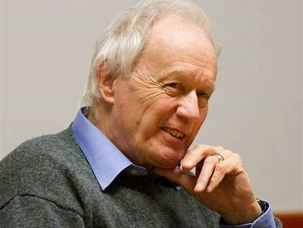
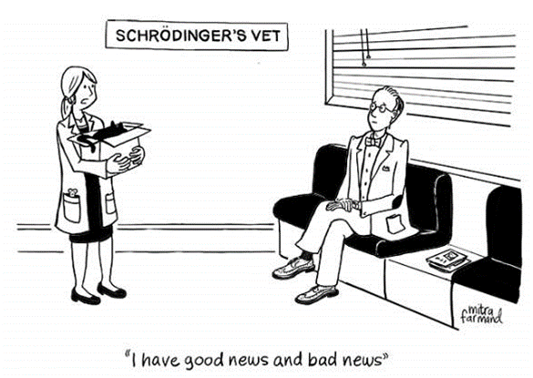
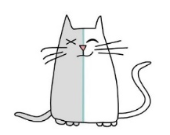
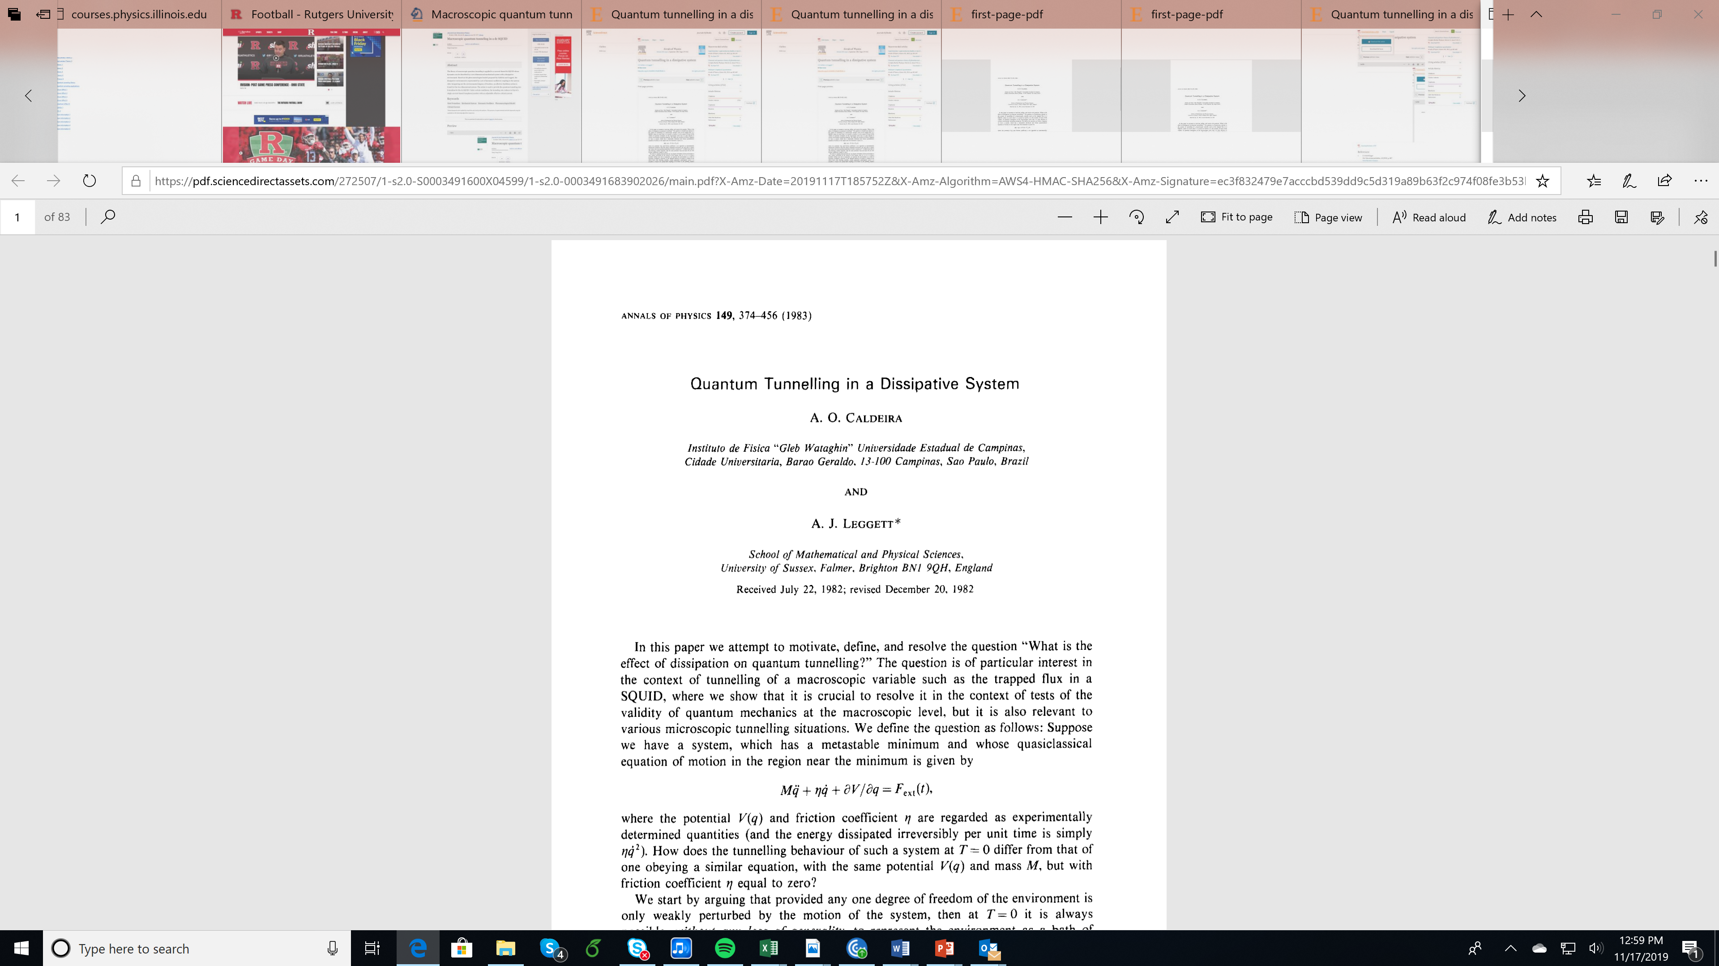

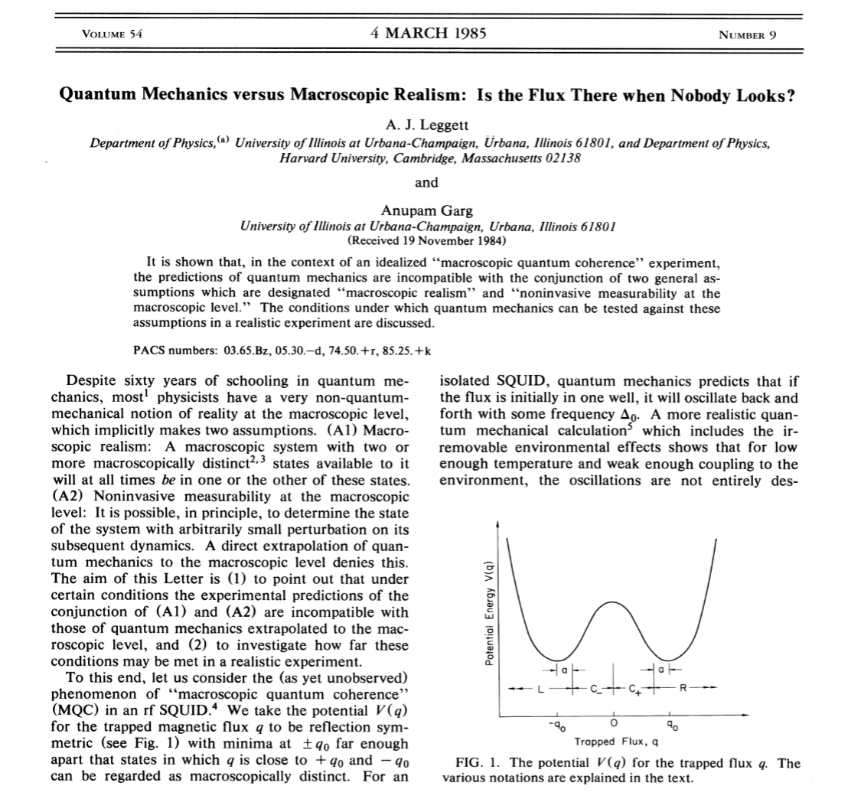
Macroscopic Quantum Coherence (MQC) ---
can a macroscopic system be in a superposition of states?
A manifestation of the Schroedinger’s cat paradox

Slide 9
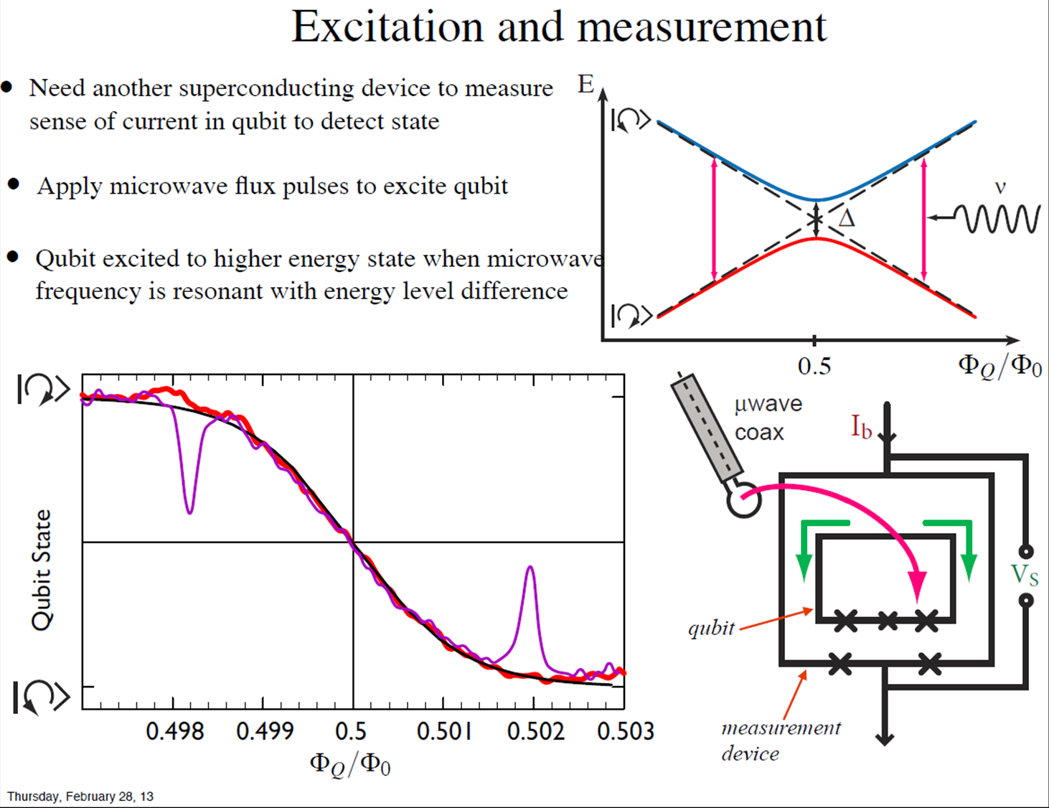
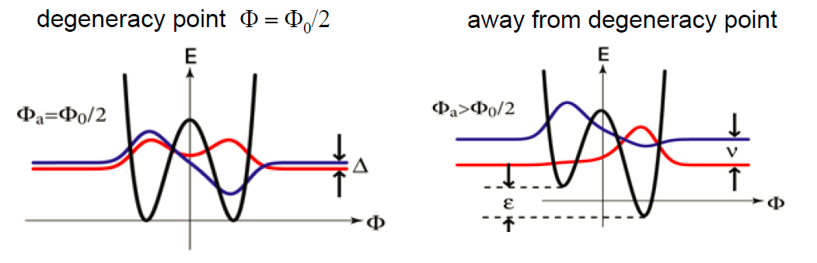




$$\frac{Φ_{0}}{2}$$
double-well potential characterized by the direction of circulating current
rf SQUID at $Φ_{x}=$
Tunnel coupling creates symmetric and anti-symmetric energy levels:
E
L
C
I_{C}
$$Δ_{ }$$
½Φ₀
Φ
Ω
Wavefunctions of the particle in the double-well potential:
Energy level separation has avoided crossing:
$$E=\sqrt{ε^{2}+Δ^{2}}$$
Φ
$Φ_{0}$/2

Slide 10
Why superconductors are good candidate?
Advantages
Intrinsically low temperature quantum devices
Energy gap suppresses low energy excitations
Zero dc resistance
Josephson effect provides periodic potential
High characteristic frequencies
Convenient device coupling via flux transformers
Established fabrication techniques
Disadvantages
Macroscopic devices --- strong coupling to environment
Strong sensitivity of Josephson tunneling to barrier details

Slide 11
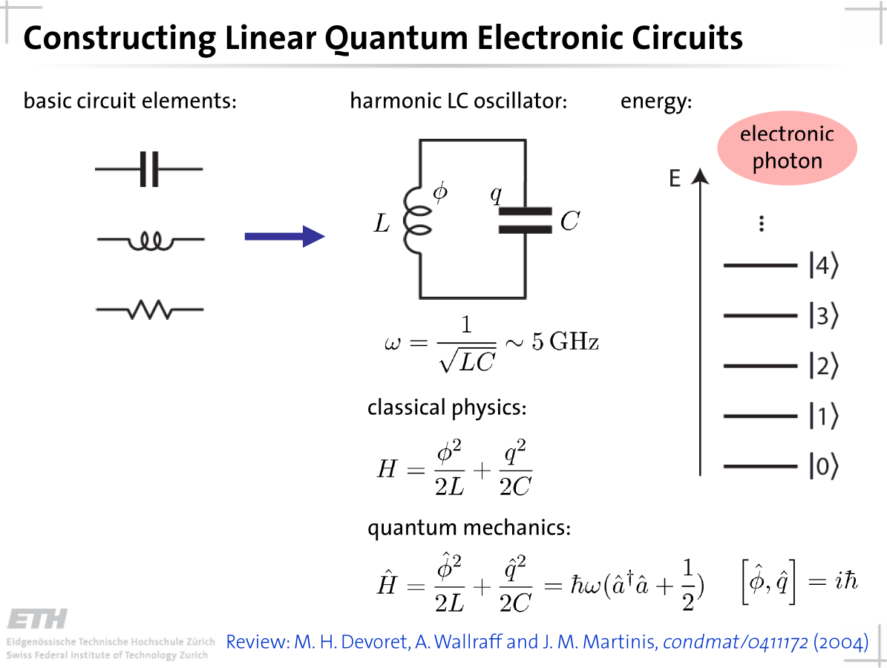

Slide 12
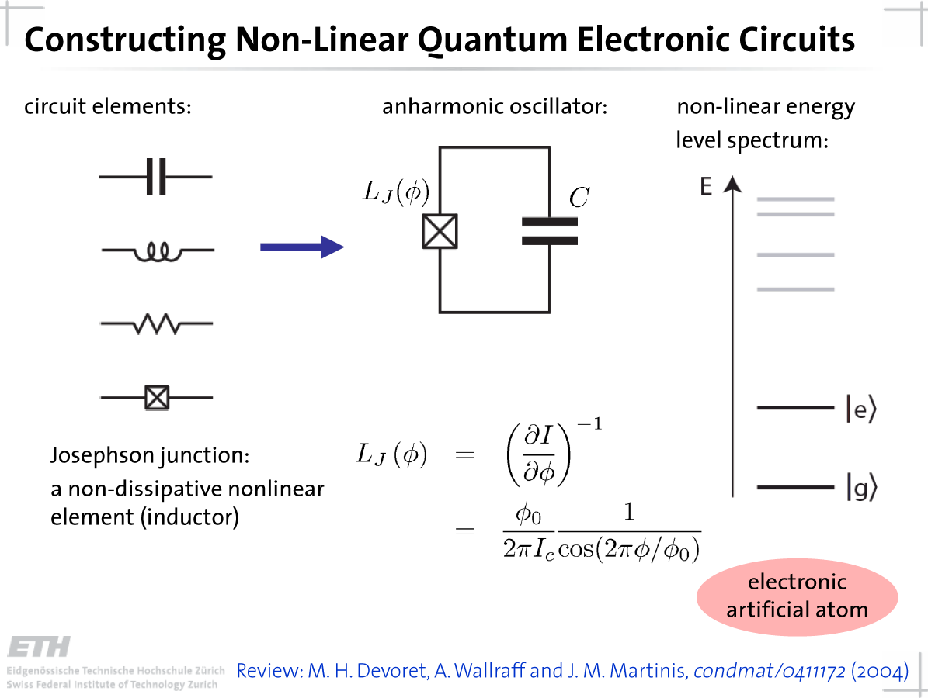

Slide 13
Superconductor Qubits
Charge qubits
  Nakamura (NEC)
  Devoret/Schoelkof (Saclay/Yale)
Phase qubits
  Martinis (NIST Boulder)
  Han (Kansas)
  Koch (IBM)
  Lobb, Wellstood (Maryland)
  Ustinov (Karlsruhe)
Flux qubits
  Lukens, Friedman (SUNY Stony Brook)
  Mooij (Delft)
  Orlando (MIT)
  Clarke (Berkeley)
  Van Harlingen (UIUC)
Hybrid charge/phase qubits --- “quantronium”
  Devoret, Esteve (Saclay)
2e
f
F

Slide 14
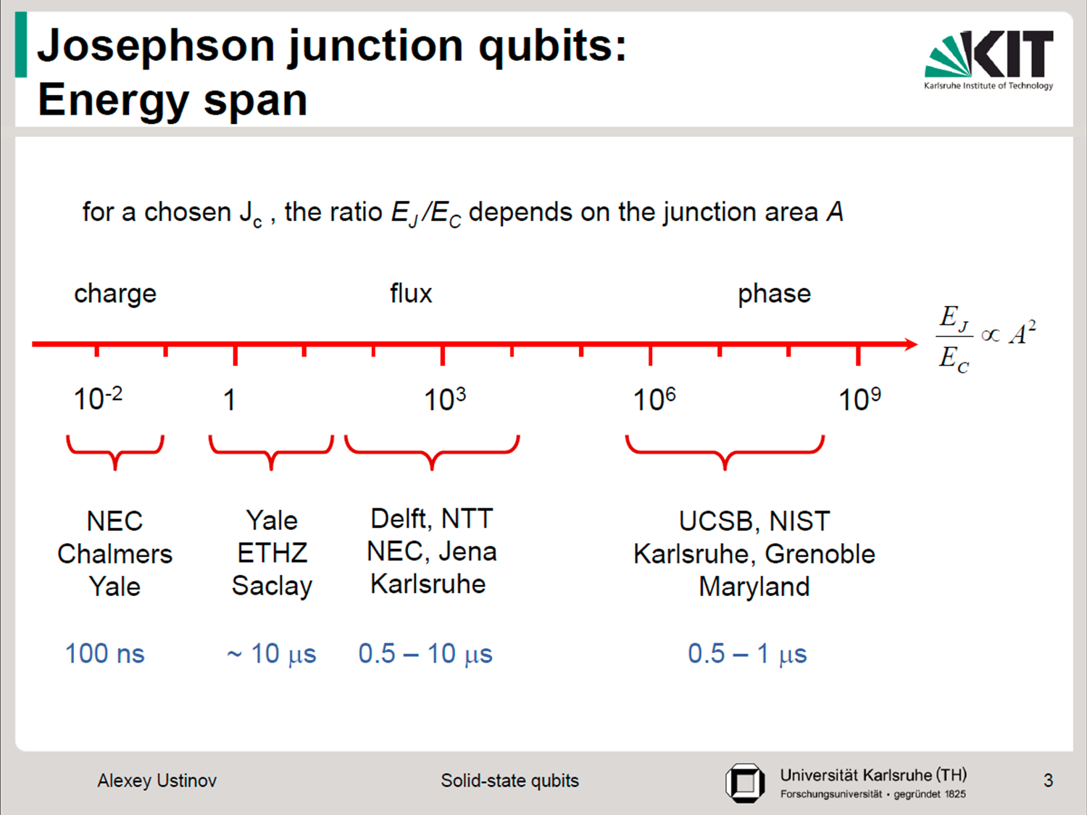
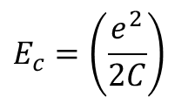
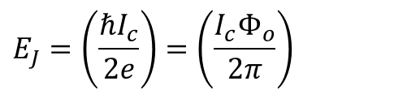


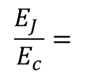
What distinguishes all of these qubits types?
Ratio of the Josephson coupling energy to the charging energy
I
$$E_{J}=\left(\frac{ℏI_{c}}{2e}\right)=\left(\frac{I_{c}Φ_{o}}{2π}\right)$$
$$E_{c}=\left(\frac{e^{2}}{2C}\right)$$
$$\frac{E_{J} }{E_{c}}=$$
$$\frac{ℏ}{e3}$$
$I_{c}$C ~ A²
V
scales as the junction area squared
Spectrum of early qubits architectures
dephasing times
BEST?

Slide 15
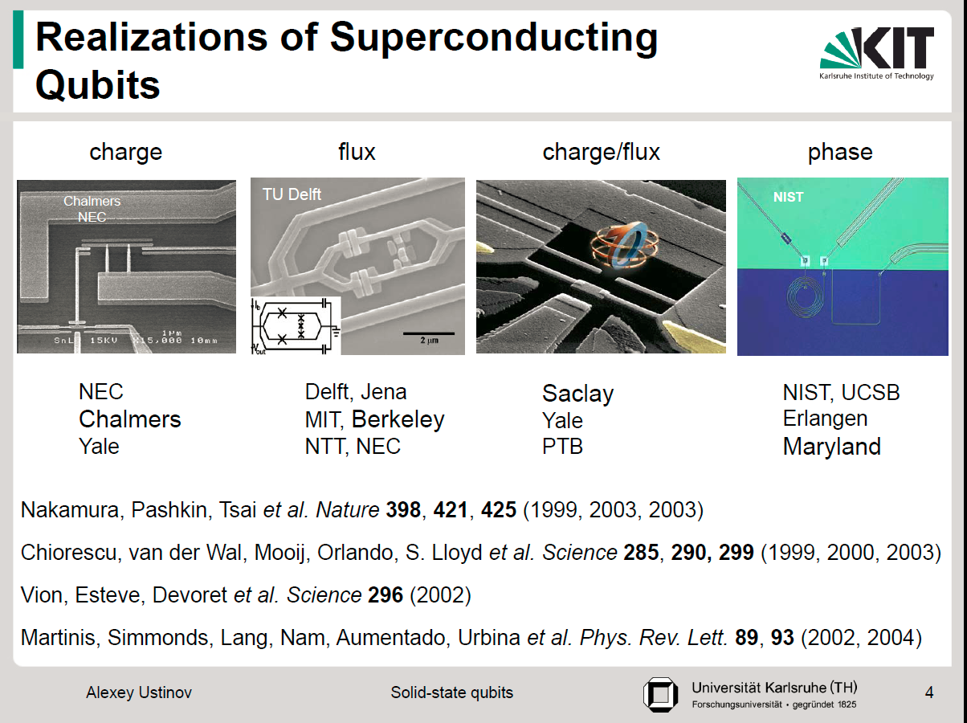

Slide 16
Characteristic signatures of qubit behavior --- evidence for superposition of quantum states
1. Avoided crossings --- evidence of energy splitting of quantum states
2. Energy relaxation --- finite lifetime in excited state (decay to ground state) --- way to measure T₁
3. Rabi oscillations --- resonances between ground and excited states
4. Ramsey fringes – dephasing resonances between ground and excited states --- way to measure T₂
5. Spin echo effects --- way to reduce dephasing

Slide 17

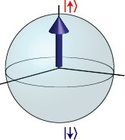
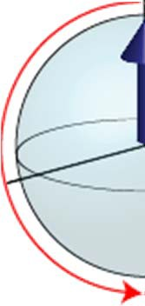

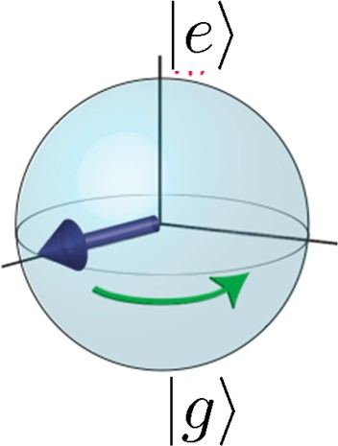
Relaxation and dephasing (T₁ and T₂)
T₁: energy relaxation time
perturbation orthogonal to quantization axis (∝ σ_{x,y}); e.g. fast charge fluctuations causing transitions
depolarization, decay
T₂: dephasing time
dephasing
slow perturbation along quantization axis (∝ σ_{z}); e.g. magnetic flux noise causing phase randomization

Slide 18

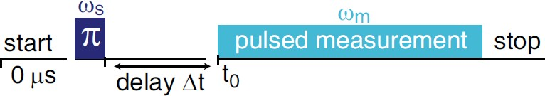

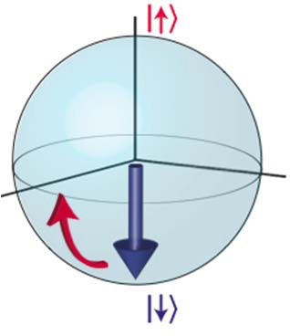

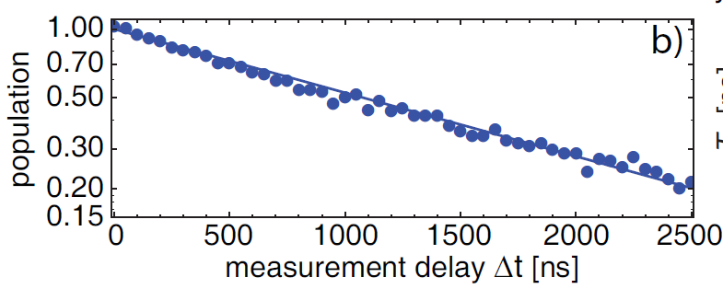

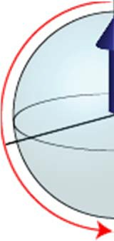


Relaxation Time (T₁) measurement
log-plot
T₁=1.2 us
R. Bianchetti, QUDEV, ETH Zurich (2010)

Slide 19
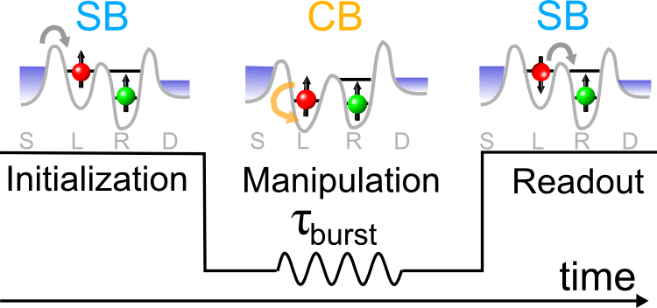
Rabi Oscillations --- drive oscillations between quantum states
z
| 0 ⟩
initialize
rotate
readout
y
τ_{burst}
x
| 1 ⟩
InSb nanowire, single spin
0.4
Current (pA)
0.2
f_{RABI} = 100 MHz
0
0
20
40
60
80
100
120
Microwave burst time (ns)

Slide 20
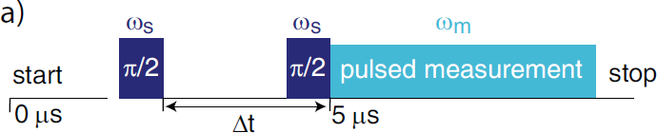


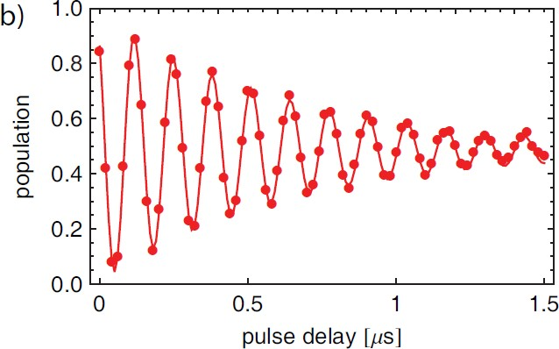
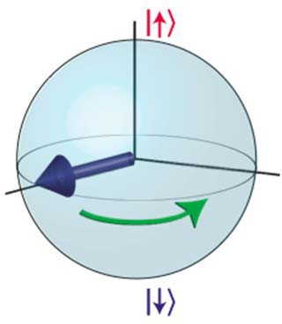


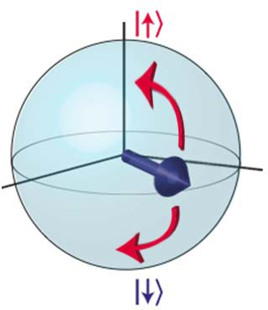

Coherence Time (T₂) Measurement: Ramsey Fringes
T₂=640 ns

Slide 21

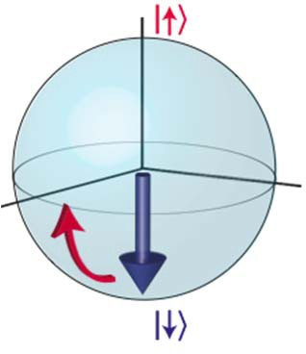


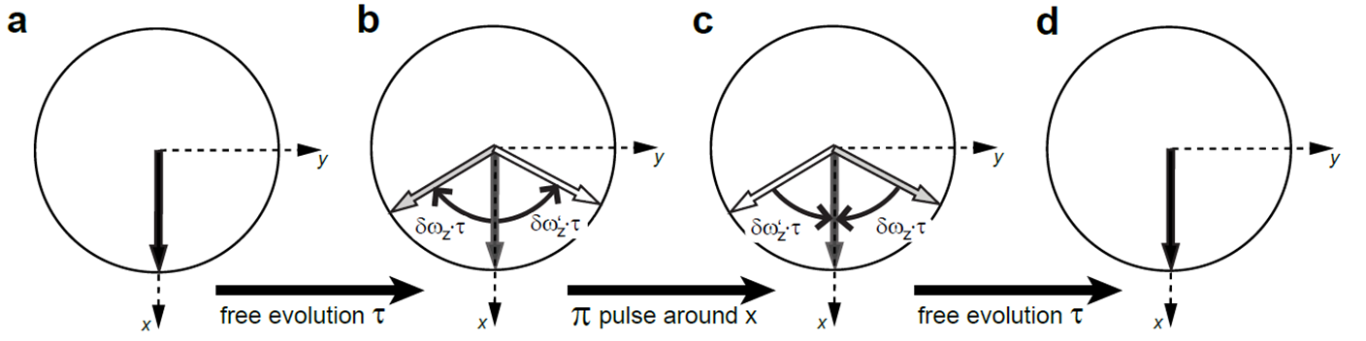
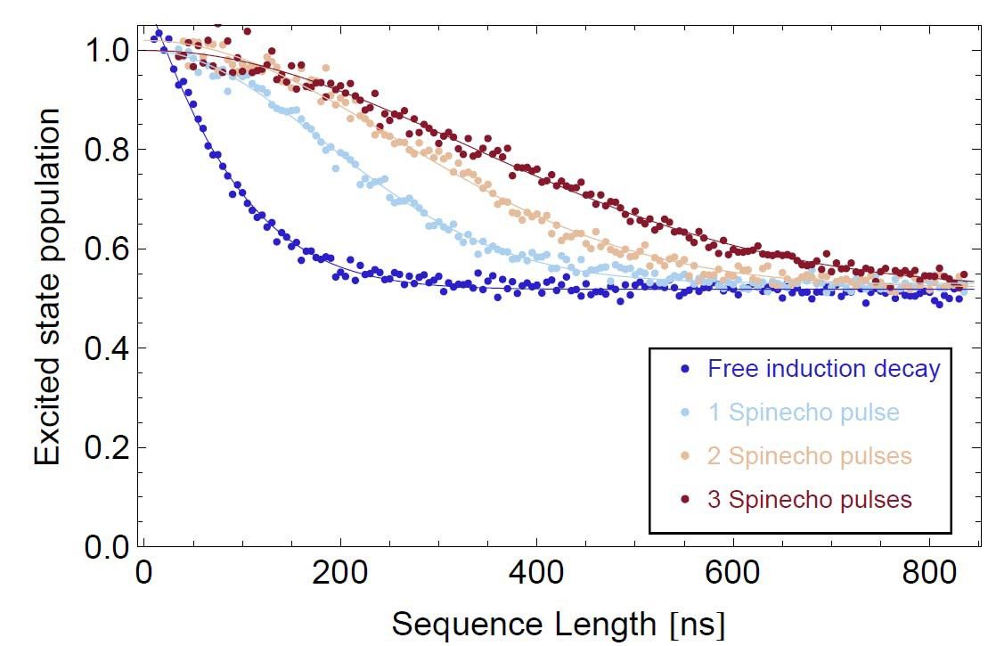
Reducing decoherence dynamically: the Spin Echo technique
Top view (along z):
Results:
refocuses qubits
eliminates low frequency noise
Increases dephasing (T₂) time

Slide 22
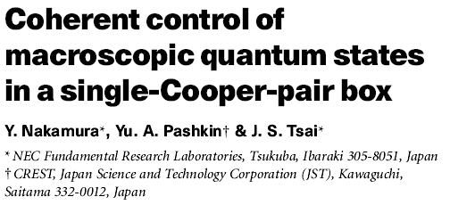
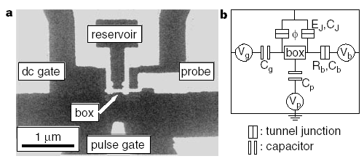
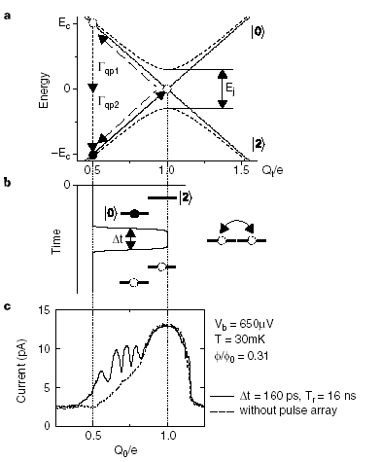
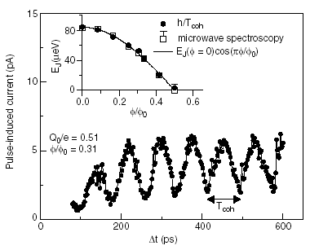

Slide 23
rf SQUID qubit
L
C
I_{C}
ΔU
½Φ₀
Barrier height:
Plasma frequency:
“Degree of classicality” :
Tunneling frequency:

Slide 24
Three-junction qubit
T. P. Orlando et al., PRL 60, 15398 (1999)
aI₀
(a < 1)
I₀
I₀
3-dimensional potential
½Φ₀
Josephson energy:
Charging energy:
Plasma frequency:
Phase minimum :
Tunneling frequency:
(intracell)

Slide 25

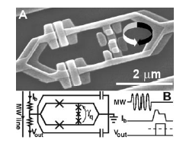
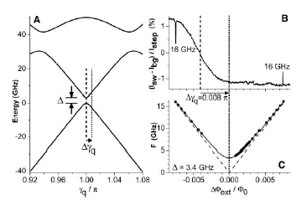
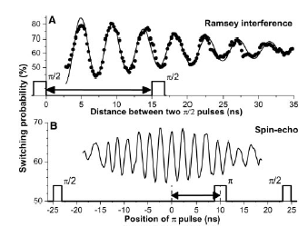
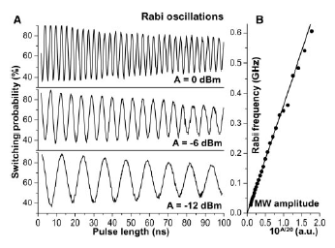

Slide 26
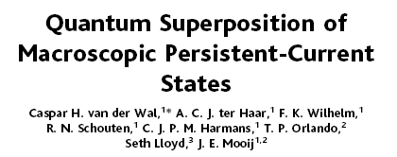
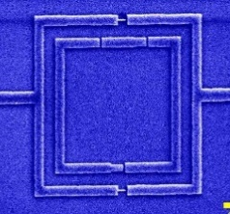
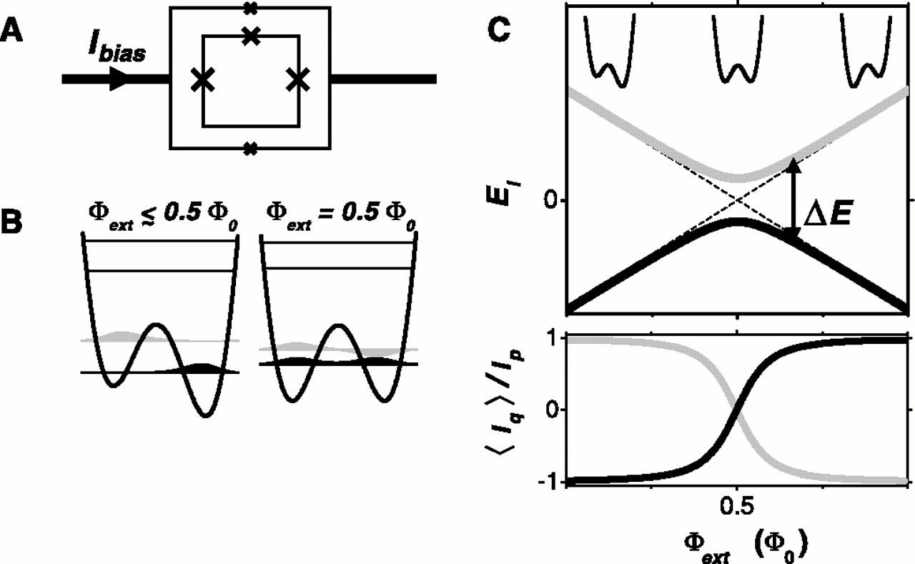
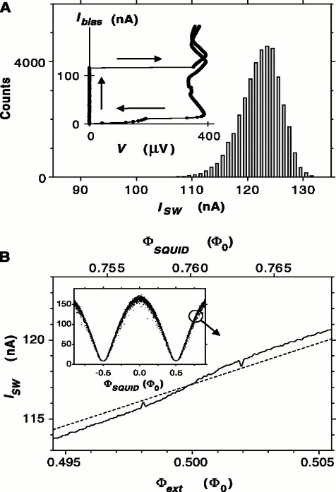



Slide 27
Phase (single Josephson junction) qubit
Current-biased single junction
Oscillations between energy levels in washboard potential well
ηΩ
I
I_{C}
C
E₁
ΔU
E₀
Barrier height:
Plasma frequency:
Tunneling frequency:

Slide 28






Slide 29

“Quantronium” --- hybrid charge/phase qubit
Operation at saddle point is insensitive to charge and phase fluctuations
Cooper pair box coupled to flux loop
C
IC
δ
readout
Ng
IC
Vg
IC
δ

Slide 30
Science 296, 886 (2002)

Slide 33


Slide 34









Trapped ions
© Innsbruck
0.2 mm
© NIST
© Innsbruck
a “qu-byte” in an ion trap (2006)

Slide 35





Electron spins in quantum dots
© TDelft
300
0,3
1,3
2,3
0,2
1,2
2,2
V_{PR} [mV]
0,1
1,1
2,1
0,0
1,0
2,0
200
250
V_{PL} [mV]
350
© Harvard

Slide 36


Impurity spins: NV centers in diamond
V
N

